Slide 1

Media & Entertainment Accelerator (v1/v2)
Solution Layering & Packaging

Slide 2


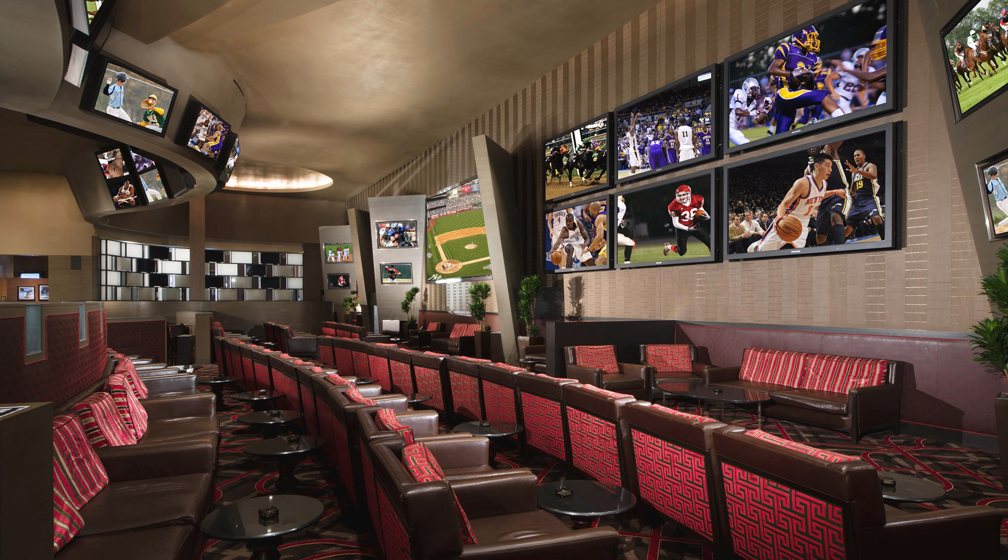
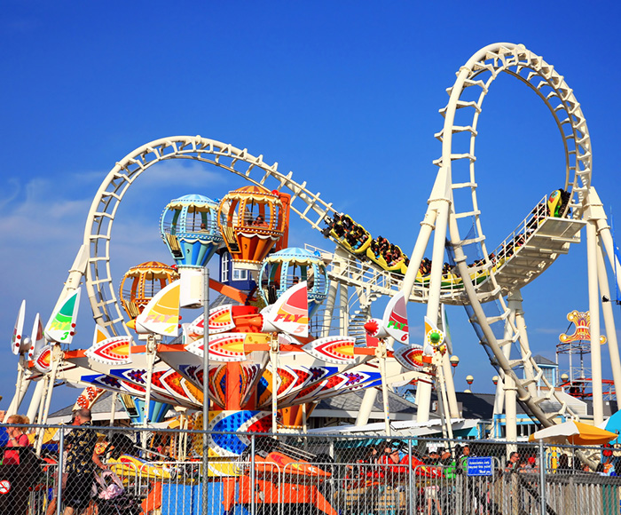

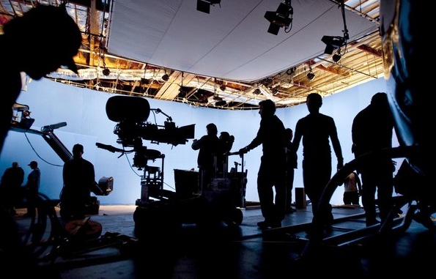
Media & Entertainment Sub-Industries
News & Publishing
Advertising & Conferences
Sports & Gaming
Tourism, Theme Parks & Hospitality
Broadcasting, Cable & Satellite, Streaming Services
Content Production Workflows, Storage,
Distribution

Slide 3

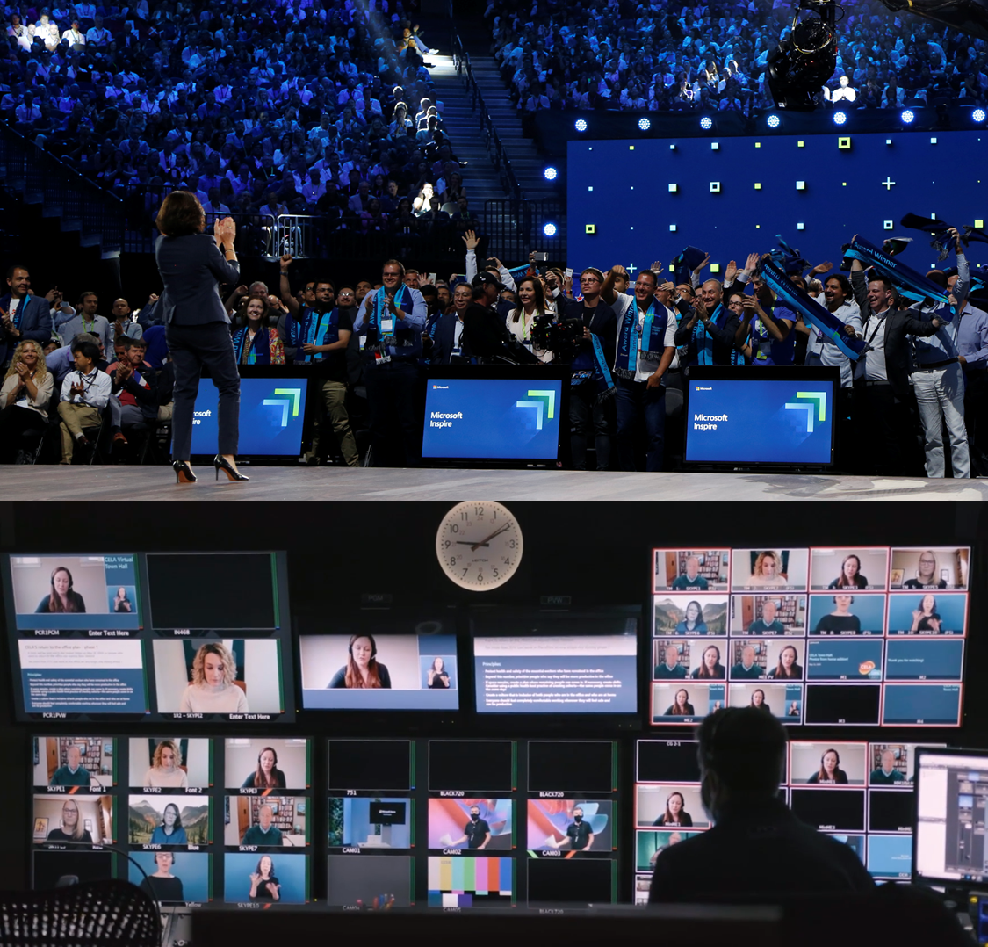
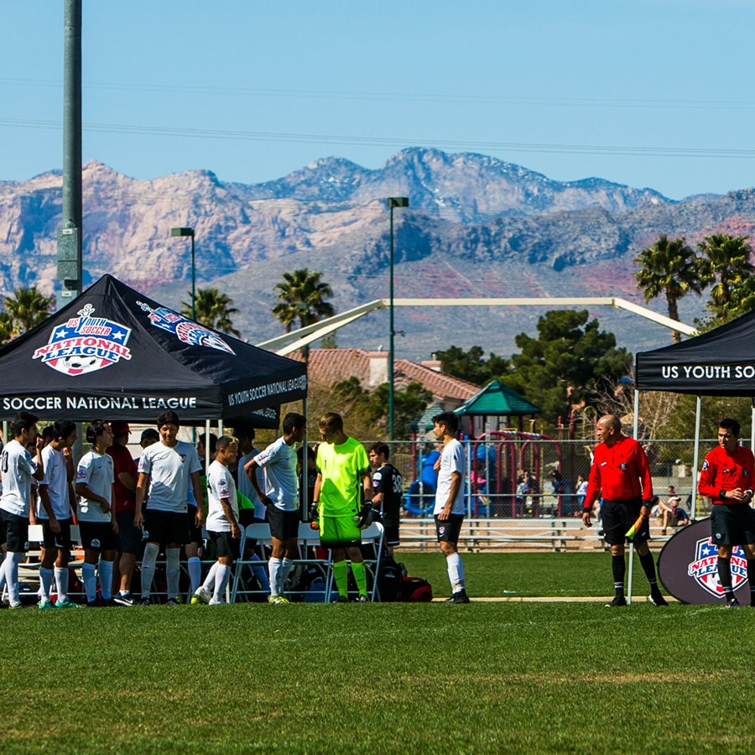
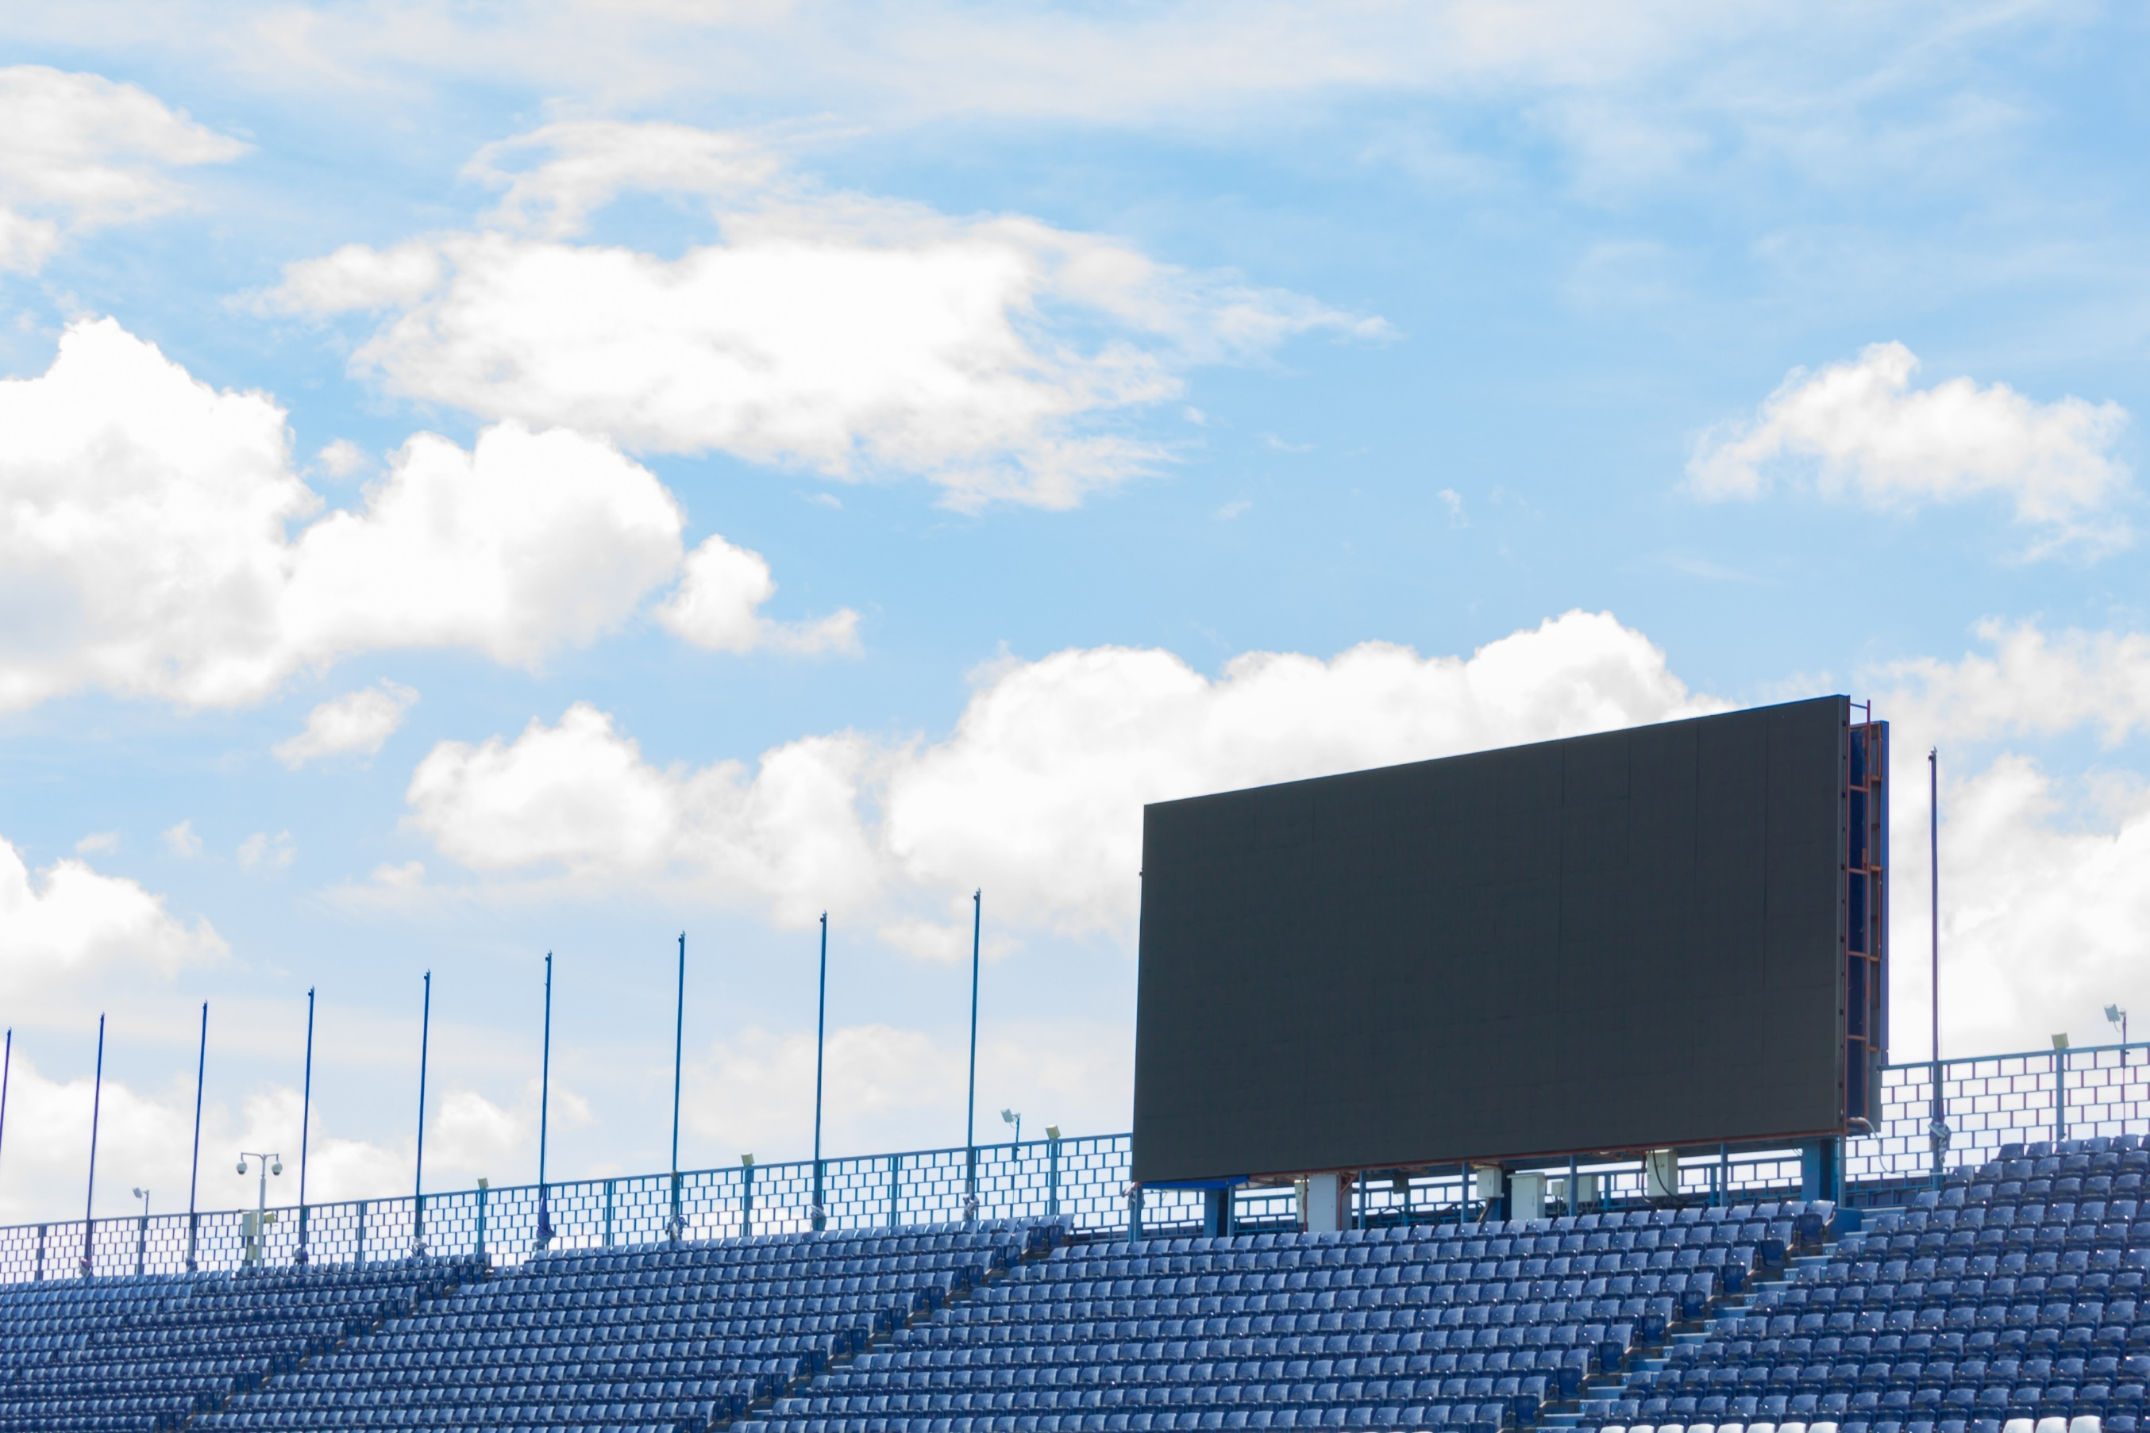

Use Cases supported with M&E Accelerator solutions
360-degree
Fan & Guest Insights
Digital Events &
Venue Management
Sports Data
Management
Sales & Marketing
Content Production
Notes:
Talking Points:
There are 4 key areas we are addressing the challenges in education today with our business applications solution;
Track fan and guest engagement
Digitize your events, attractions, and venues
Manage your data across your sports organization
Energize your product and ticket sales
More details:
Create apps quickly for a variety of purposes, driven by your organization’s needs and imagination
Keep up with the rapidly changing needs of your customers, fans, patrons, visitors or guests
Find new ways to connect with, convert, enable, empower, protect or reward internal and external audiences
Support a better experience for your employees and customers however they want to engage

Slide 4
Media and Entertainment Accelerator - Solution Layering and Packaging
ISV Partner Apps
ISV Partner Apps
Event Registration Portal App
Azure Storage, Azure Compute,
Azure Video Analyzer, AI
Apps Layer
Microsoft365
Power Apps Portals
Ticketing & Media Product Sales Model Driven Apps
Power Automate
Events/Venues
Model Driven App
Guest Mgmt
Model Driven App
Sports Mgmt
Model Driven App
Dynamics 365 Sales
Content Production
Model Driven App
Fan Engagement Solution
Content Production Solution
Media Common
Data Layer
Dataverse / Common Data Model
Power Platform

Slide 5
Fan Engagement Solution
Driving apps that manage fans and guest experiences and data across media assets and venues

Slide 6
Fan Engagement Solution
Packaging & Layering
Media Registration Portal
Media Apps
(Model Driven Applications Only)
Power Apps Portals
Media Apps Teams Integration
(Flows and Connection References for Media Teams Integration)
Media Sports Event Product Sales
(Sports Enriched Forms for Model Driven Applications Only)
Media Custom Connectors
(Media Teams Integration Connector Only)
Media Event Product Sales
M365 Teams
Dynamics 365 Sales
Media Sports
Media Events & Venues
Media Common
Media Asset CDM
Microsoft Dataverse
Media Accelerator Component Solutions
Existing Microsoft 1st Party Solutions

Slide 7
Media Asset CDM -> Primary Tables
Media Registration Portal
Media Apps
Power Apps Portals
Media Apps Teams Integration
Media Sports Event Product Sales
Media Custom Connectors
Media Event Product Sales
M365 Teams
Dynamics 365 Sales
Media Sports
Media Events & Venues
Media Common
Table Name
Media Asset
Media Asset Category
Media Asset CDM
Microsoft Dataverse

Slide 8
Media Common -> Primary Tables
Media Registration Portal
Media Apps
Power Apps Portals
Media Apps Teams Integration
Media Sports Event Product Sales
Entity Name
Business Role
TMA
External Guest ID
Guest
Guest Category
Interest
Loyalty Level
Loyalty Program
Loyalty Program Account
Region
Season
Talent
Three Digit Zip Code
Media Custom Connectors
Media Event Product Sales
M365 Teams
Dynamics 365 Sales
Media Sports
Media Events & Venues
Media Common
Media Asset CDM
Microsoft Dataverse

Slide 9
Media Common -> Enriched Tables
Media Registration Portal
Media Apps
Power Apps Portals
Media Apps Teams Integration
Media Sports Event Product Sales
Media Custom Connectors
Media Event Product Sales
M365 Teams
Dynamics 365 Sales
Media Sports
Media Events & Venues
Entity Name | Source
Contact | CDM Common
Media Asset | Media Asset CDM
Media Asset Category | Media Asset CDM
Media Common
Media Asset CDM
Microsoft Dataverse

Slide 10
Media Events & Venues -> Primary Tables
Entity Name
Attraction
Attraction Schedule
Attraction Track
Concession Partner
Concession Stand
Dispenser
Event Attraction
Event Schedule
Facility
Gate
Hours of Operation
Media Event
Media Registration
Media Registration Status Log
Media Venue
Media Venue Image
Weather Condition
Media Registration Portal
Media Apps
Power Apps Portals
Media Apps Teams Integration
Media Sports Event Product Sales
Media Custom Connectors
Media Event Product Sales
M365 Teams
Dynamics 365 Sales
Media Sports
Media Events & Venues
Media Common
Media Asset CDM
Microsoft Dataverse

Slide 11
Media Events & Venues -> Enriched Tables
Media Registration Portal
Media Apps
Power Apps Portals
Media Apps Teams Integration
Media Sports Event Product Sales
Media Custom Connectors
Media Event Product Sales
M365 Teams
Dynamics 365 Sales
Media Sports
Entity Name | Source
Contact | Media Common
Guest | Media Common
Media Asset | Media Common
Talent | Media Common
Media Events & Venues
Media Common
Media Asset CDM
Microsoft Dataverse

Slide 12
Media Sports -> Primary Tables
Media Registration Portal
Media Apps
Entity Name
League
Playing Field
Playing Field Image
Playing Field Point
Round
Sporting Conference
Sporting Division
Sports Player
Sports Player Image
Sports Player Team History
Sports Team
Power Apps Portals
Media Apps Teams Integration
Media Sports Event Product Sales
Media Custom Connectors
Media Event Product Sales
M365 Teams
Dynamics 365 Sales
Media Sports
Media Events & Venues
Media Common
Media Asset CDM
Microsoft Dataverse

Slide 13
Media Sports -> Enriched Tables
Media Registration Portal
Media Apps
Power Apps Portals
Media Apps Teams Integration
Media Sports Event Product Sales
Media Custom Connectors
Media Event Product Sales
Entity Name | Source
Account | CDM Common
Event Schedule | Media Events & Venues
Guest | Media Common
Media Event | Media Events & Venues
Media Registration | Media Events & Venues
Media Registration Status Log | Media Events & Venues
Weather Condition | Media Events & Venues
M365 Teams
Dynamics 365 Sales
Media Sports
Media Events & Venues
Media Common
Media Asset CDM
Microsoft Dataverse

Slide 14
Media Event Product Sales -> Primary Tables
Media Registration Portal
Media Apps
Entity Name
Admission
Advertising Segment
Advertising Segment Group
Advertising Spot Fulfillment
Media Event Sponsorship
Media Venue Advertising Zone
Media Venue Seat Map
Product Image
Promo Code
Seat
Seat Map
Seat Row
Seat Section
Seat Tier
Ticket
Power Apps Portals
Media Apps Teams Integration
Media Sports Event Product Sales
Media Custom Connectors
Media Event Product Sales
M365 Teams
Dynamics 365 Sales
Media Sports
Media Events & Venues
Media Common
Media Asset CDM
Microsoft Dataverse

Slide 15
Media Event Product Sales -> Enriched Tables
Entity Name | Source
Account | CDM Common
Contact | CDM Common
Attraction | Media Events & Venues
Concession Stand | Media Events & Venues
Event Attraction | Media Events & Venues
Facility | Media Events & Venues
Guest | Media Common
Lead | Dynamics 365 Sales
Media Asset | Media Common
Media Event | Media Events & Venues
Media Venue | Media Events & Venues
Opportunity Product | Dynamics 365 Sales
Order Product | Dynamics 365 Sales
Order | Dynamics 365 Sales
Price List | Dynamics 365 Sales
Product | Dynamics 365 Sales
Quote Product | Dynamics 365 Sales
Media Registration Portal
Media Apps
Power Apps Portals
Media Apps Teams Integration
Media Sports Event Product Sales
Media Custom Connectors
Media Event Product Sales
M365 Teams
Dynamics 365 Sales
Media Sports
Media Events & Venues
Media Common
Media Asset CDM
Microsoft Dataverse

Slide 16
Media Sports Events Product Sales -> Enriched Tables
Media Registration Portal
Media Apps
Power Apps Portals
Media Apps Teams Integration
Media Sports Event Product Sales
Entity Name | Source
Media Event | Media Events & Venues
Media Custom Connectors
Media Event Product Sales
M365 Teams
Dynamics 365 Sales
Media Sports
Media Events & Venues
Media Common
Media Asset CDM
Microsoft Dataverse

Slide 17
Media Registration Portal -> Enriched Tables
Media Registration Portal
Media Apps
Entity Name | Source
Guest | Media Common
Power Apps Portals
Media Apps Teams Integration
Media Sports Event Product Sales
Media Custom Connectors
Media Event Product Sales
M365 Teams
Dynamics 365 Sales
Media Sports
Media Events & Venues
Media Common
Media Asset CDM
Microsoft Dataverse

Slide 18
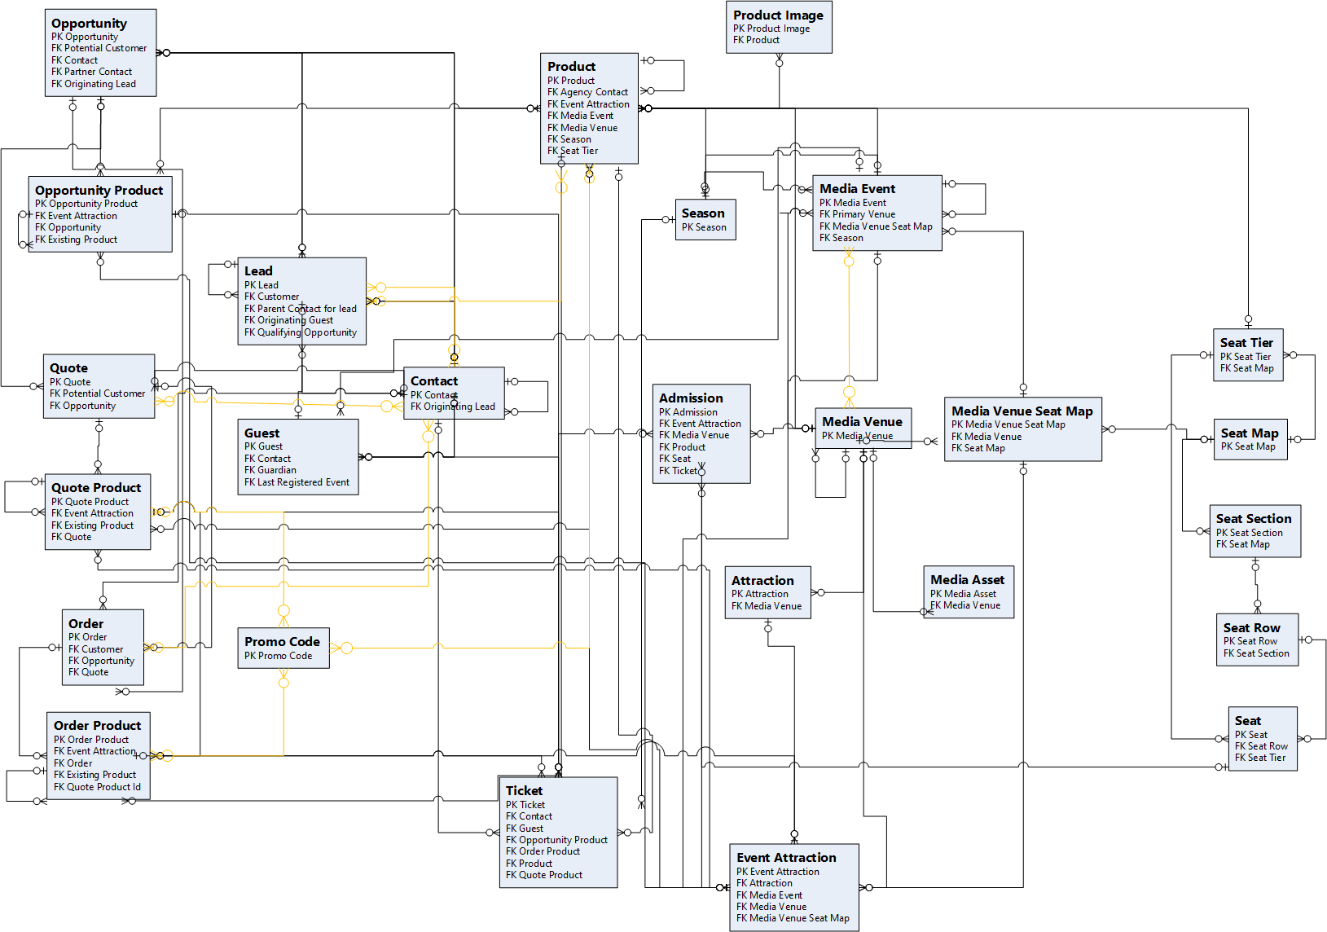
ERD – Ticket Sales

Slide 19
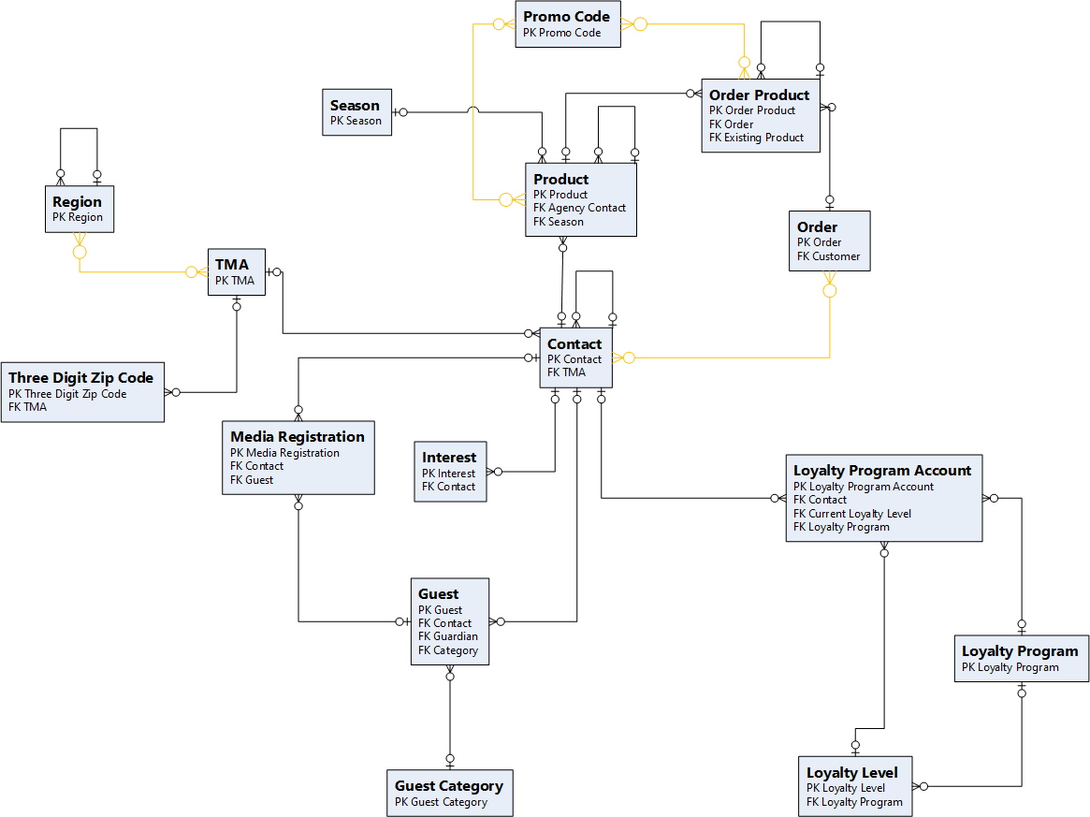
ERD – Guest Management

Slide 20
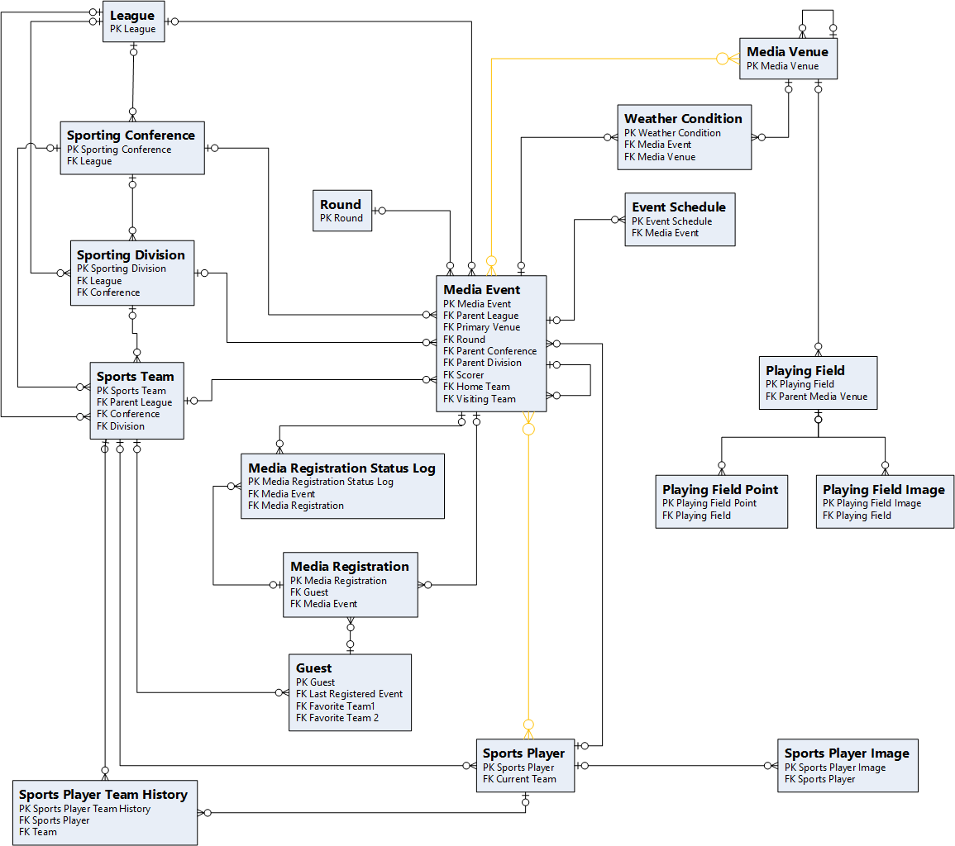
ERD – Sports Management

Slide 21
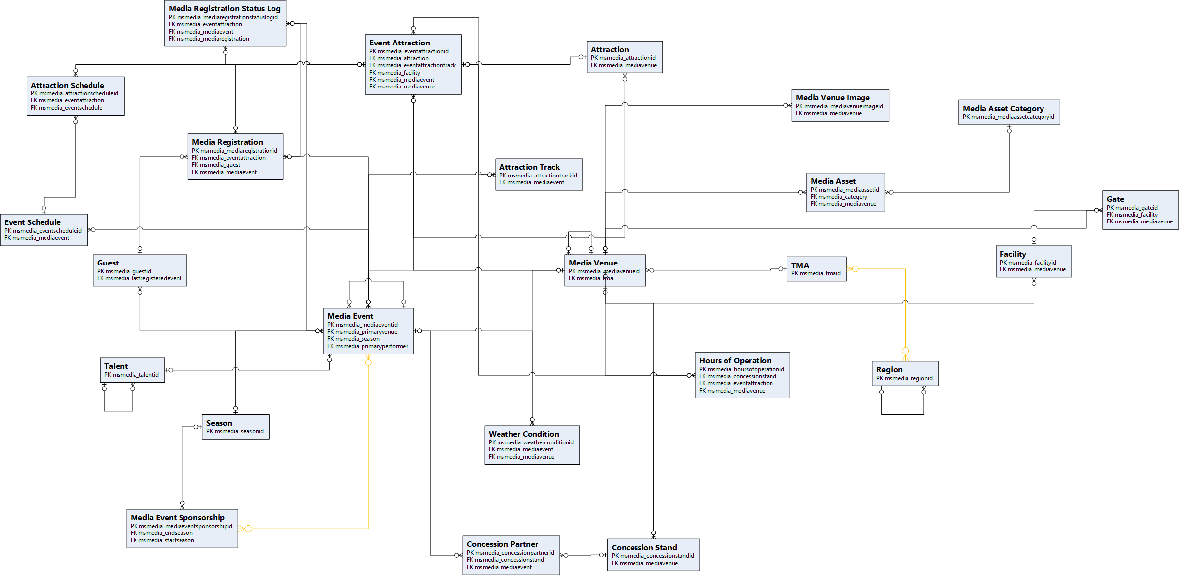
ERD – Media Events & Venues

Slide 22
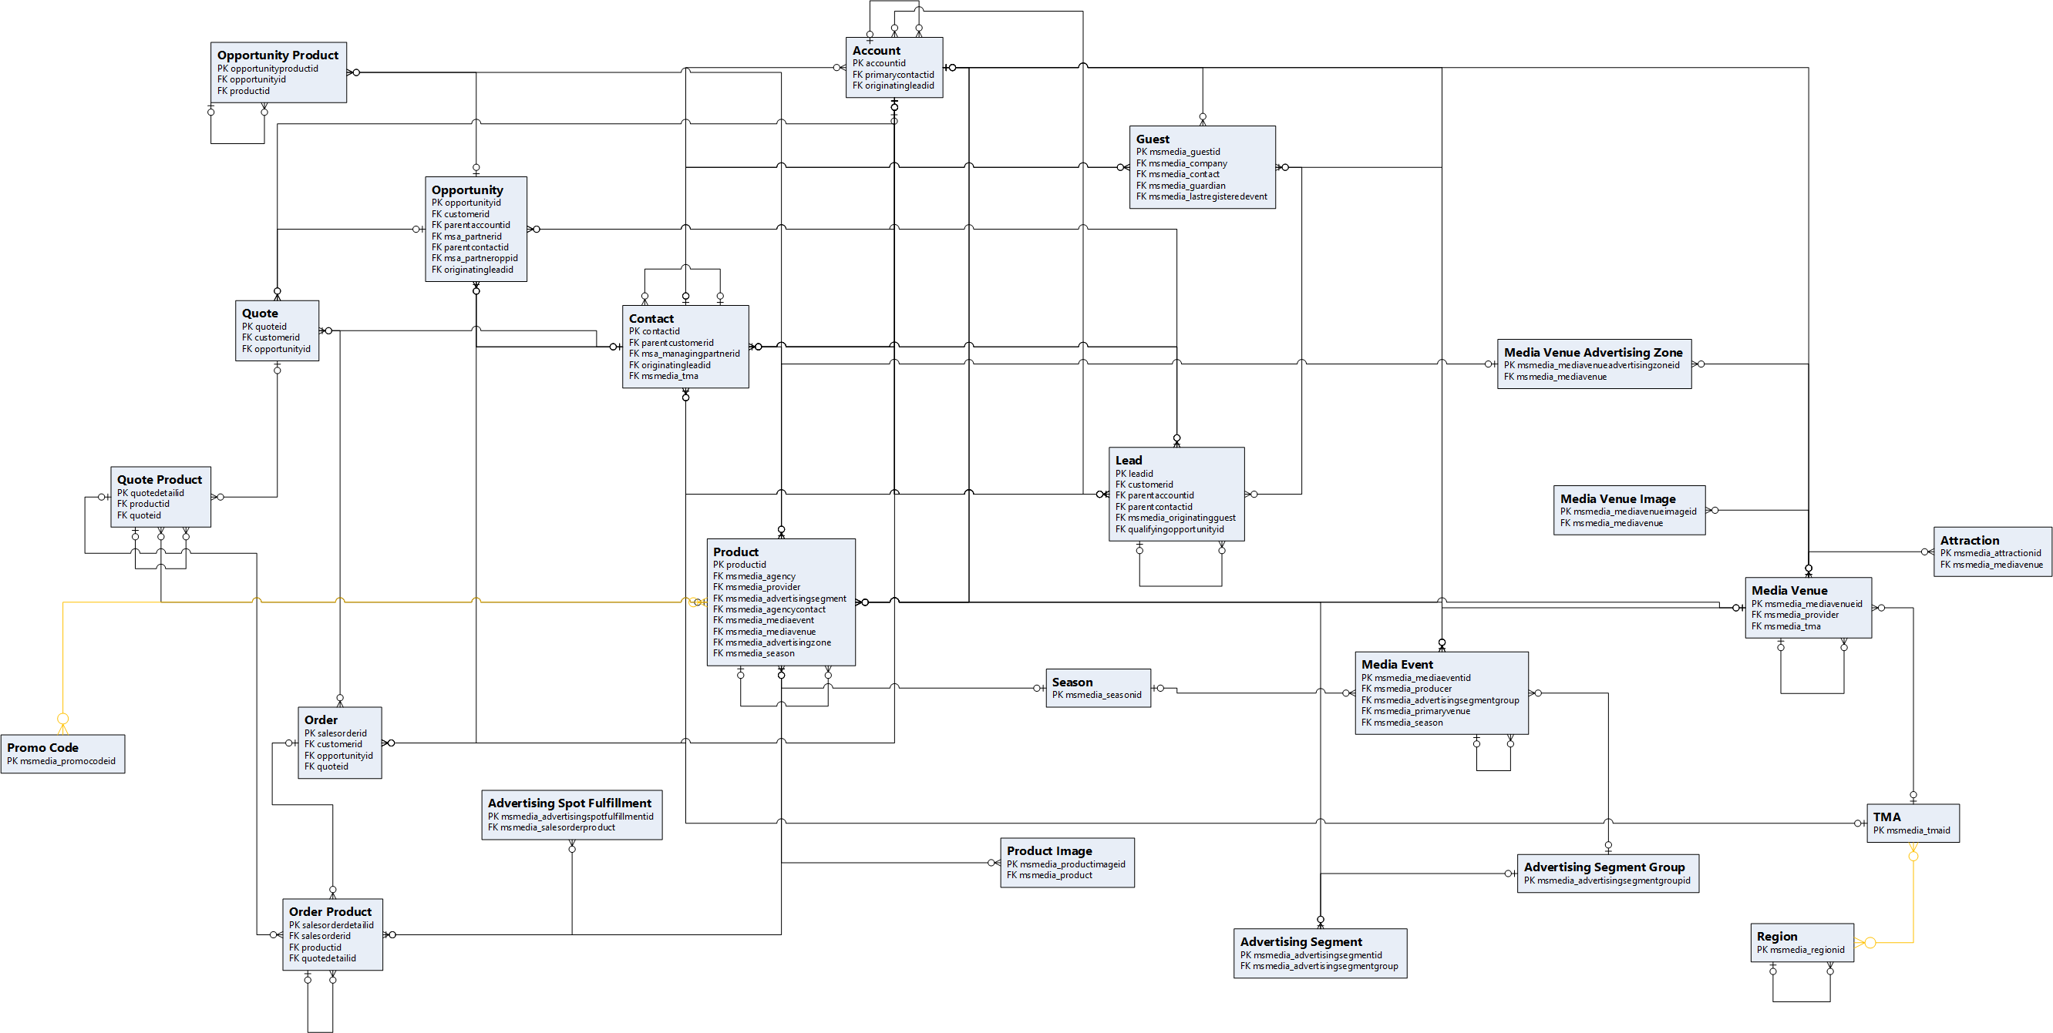
ERD – Ad Sales

Slide 23
Content Production Solution (Upcoming)
Driving apps that help manage the workflows and data from the production pipeline, from pre-production and creative planning through asset distribution.

Slide 24
Media Content Production Management Solution
Packaging & Layering
Media Content Production Apps
Media Content Production CDM
Media Asset CDM
Microsoft Dataverse
Media Accelerator Component Solutions
Existing Microsoft 1st Party Applications Solutions

Slide 25
Media Asset CDM -> Primary Tables
Media Content Production Apps
Media Content Production CDM
Table Name
Asset
Media Asset Category
Media Asset CDM
Microsoft Dataverse

Slide 26
Media Content Production CDM -> Primary Tables
Table Name
Asset Block
Asset File Location
Asset Metadata
Asset Metadata Attribute
Episode
Media Asset Activity
Media Asset File
Season
Show
Show Vendor Mapping
Studio
Track
Media Content Production Apps
Media Content Production CDM
Media Asset CDM
Microsoft Dataverse

Slide 27
Media Content Production CDM -> Enriched Tables
Media Content Production Apps
Table Name
Account
Asset
Media Content Production CDM
Media Asset CDM
Microsoft Dataverse

Slide 28
Media Content Production CDM -> Apps
Media Content Production Apps
Apps
Content Production
Media Content Production CDM
Media Asset CDM
Microsoft Dataverse

Slide 29
ERD

